Slide 1
Neural Network Simulation
-Simulation Overview
-Activation Function
-Single Neuron Structure
Hongjun (Jack) Wu

Slide 2
Step One.
Connect a brain to your computer.
We start by opening up one unfortunate human’s head and take out his or her brain, then Google ‘How to connect a brain to a laptop via USB’.

Slide 3
You Can’t.
You simply can’t. Our computer only recognize 0 and 1.

Slide 4
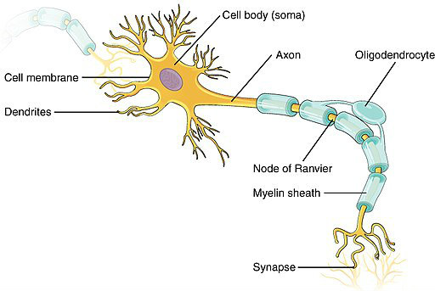
So we simulate a brain.
Axon
Sends out a signal.
Dendrites
Receives signal.
Synapse
Connects and transfers signal from one axon to some dendrites on another nerve.

Slide 5
Activation
More in detail about how Synapse works.
As we said before, the Synapse sends out signal. It experiences an ‘activation’ process. When the voltage on the axon reaches a certain value, it sends out an electric pulse to the next dendrite.

Slide 6
Process Map
Input some data.
Activate and transfer some data.
Receive some data.

Slide 7
Simulation Process
1
x1
Activation Function
y
x2
x3
Input data.
Activate and transfer data.
Receive some data.

Slide 8
Simulation Process
1
w0
x1
w1
Ʃ
y
x2
w2
w3
x3
y = activation function(w0 + w1x1 + w2x2 + w3x3)
Input data.
Activate and transfer data.
Receive some data.

Slide 9
Explanation
y = activation function(w0 + w1x1 + w2x2 + w3x3)
x(x1, x2, x3, …): Input data, simulates Axon in a real neuron.
y: Output, simulates Dendrites, and there is only one output.
w(w0, w1, w2, w3): Weight, simulates the Synapse, and connects input to output.
Activation function: Simulates how neurons activates each other. When the sum(w0 + w1x1 + w2x2 + w3x3) is larger than the critical value, the neuron passes data down to the next neuron.

Slide 10
One Neuron
Input x[1], …, x[n], and intercept x[0] = 1
Sum pass through an activate function.
Output y

Slide 11
END

Slide 12
UNUSED SLIDES

Slide 13
1.
Connect a brain to your computer.
We start by opening up one unfortunate human’s head and take out his or her brain, then Google ‘How to connect a brain to a laptop via USB’.

Slide 14
Instructions for use
EDIT IN GOOGLE SLIDES
Click on the button under the presentation preview that says "Use as Google Slides Theme".
You will get a copy of this document on your Google Drive and will be able to edit, add or delete slides.
You have to be signed in to your Google account.
EDIT IN POWERPOINT®
Click on the button under the presentation preview that says "Download as PowerPoint template". You will get a .pptx file that you can edit in PowerPoint.
Remember to download and install the fonts used in this presentation (you’ll find the links to the font files needed in the Presentation design slide)
More info on how to use this template at www.slidescarnival.com/help-use-presentation-template
This template is free to use under Creative Commons Attribution license. You can keep the Credits slide or mention SlidesCarnival and other resources used in a slide footer.

Slide 15

Hello!
I am Jayden Smith
I am here because I love to give presentations.
You can find me at @username

Slide 16
“Quotations are commonly printed as a means of inspiration and to invoke philosophical thoughts from the reader”

Slide 17
This is a slide title
Here you have a list of items
And some text
But remember not to overload your slides with content
Your audience will listen to you or read the content, but won’t do both.

Slide 18
You can also split your content
White
Is the color of milk and fresh snow, the color produced by the combination of all the colors of the visible spectrum.
Black
Is the color of coal, ebony, and of outer space. It is the darkest color, the result of the absence of or complete absorption of light.

Slide 19
In two or three columns
Yellow
Is the color of gold, butter and ripe lemons. In the spectrum of visible light, yellow is found between green and orange.
Blue
Is the colour of the clear sky and the deep sea. It is located between violet and green on the optical spectrum.
Red
Is the color of blood, and because of this it has historically been associated with sacrifice, danger and courage.

Slide 20
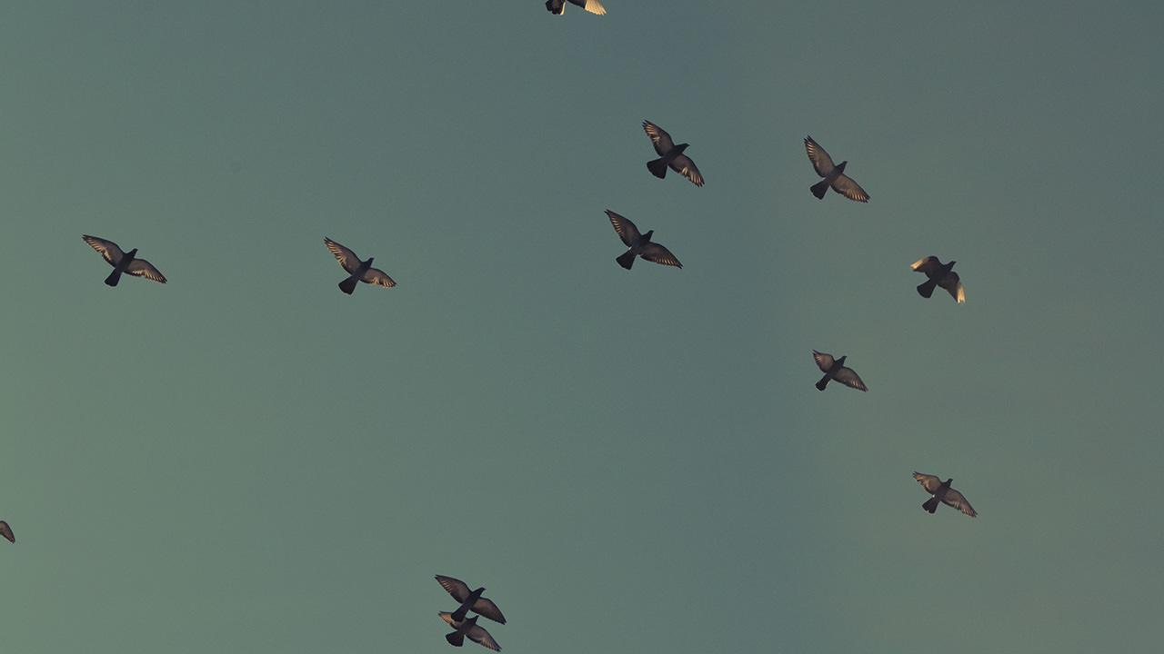
A picture is worth a thousand words
A complex idea can be conveyed with just a single still image, namely making it possible to absorb large amounts of data quickly.

Slide 21
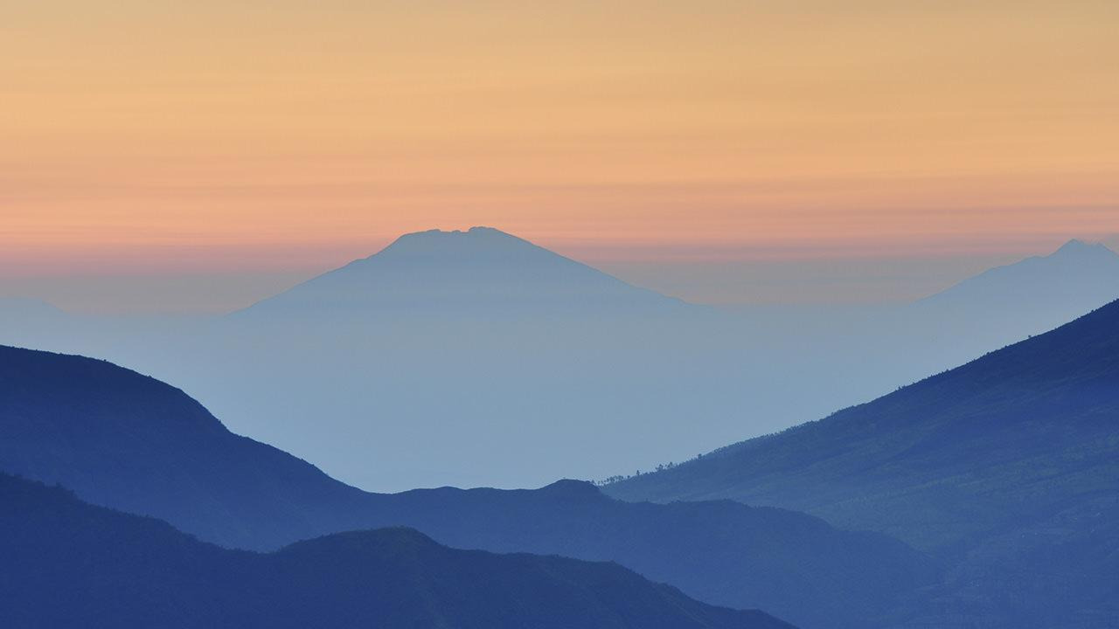
Want big impact?
Use big image.

Slide 22
Use charts to explain your ideas
White
Gray
Black

Slide 23
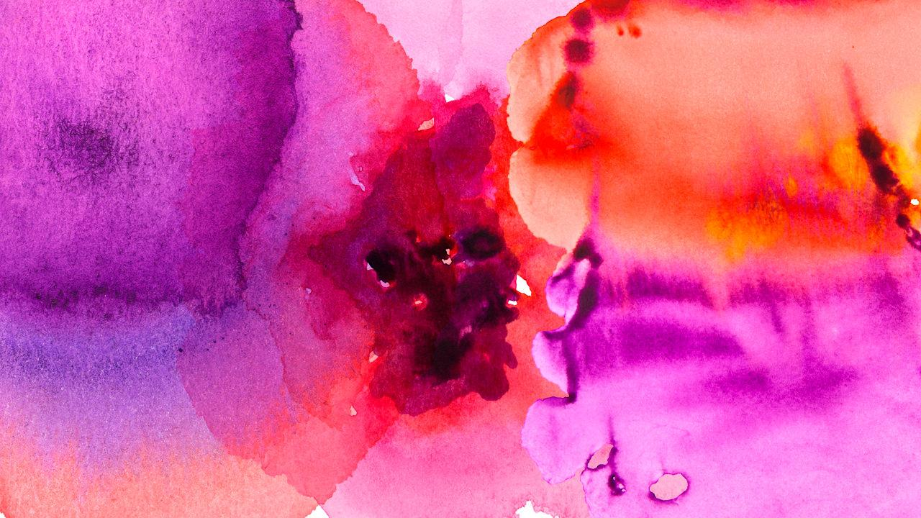
And tables to compare data
 | A | B | C
Yellow | 10 | 20 | 7
Blue | 30 | 15 | 10
Orange | 5 | 24 | 16

Slide 24
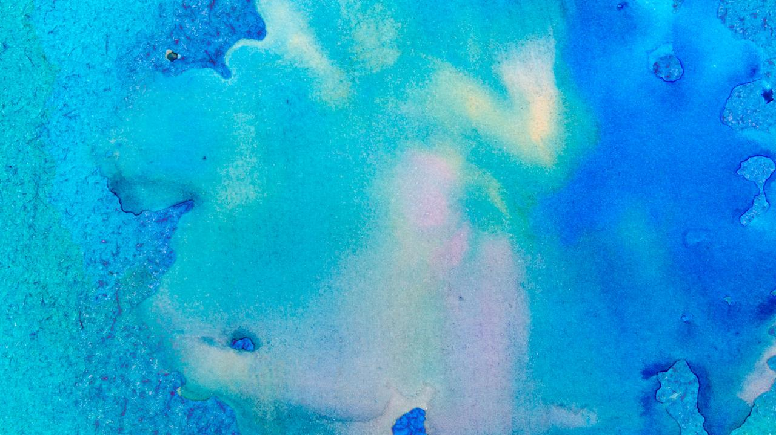
Maps
our office

Slide 25
89,526,124
Whoa! That’s a big number, aren’t you proud?

Slide 26
89,526,124$
185,244 users
100%
That’s a lot of money
And a lot of users
Total success!

Slide 27
Our process is easy
first
second
last

Slide 28
Let’s review some concepts
Yellow
Is the color of gold, butter and ripe lemons. In the spectrum of visible light, yellow is found between green and orange.
Blue
Is the colour of the clear sky and the deep sea. It is located between violet and green on the optical spectrum.
Red
Is the color of blood, and because of this it has historically been associated with sacrifice, danger and courage.
Yellow
Is the color of gold, butter and ripe lemons. In the spectrum of visible light, yellow is found between green and orange.
Blue
Is the colour of the clear sky and the deep sea. It is located between violet and green on the optical spectrum.
Red
Is the color of blood, and because of this it has historically been associated with sacrifice, danger and courage.

Slide 29
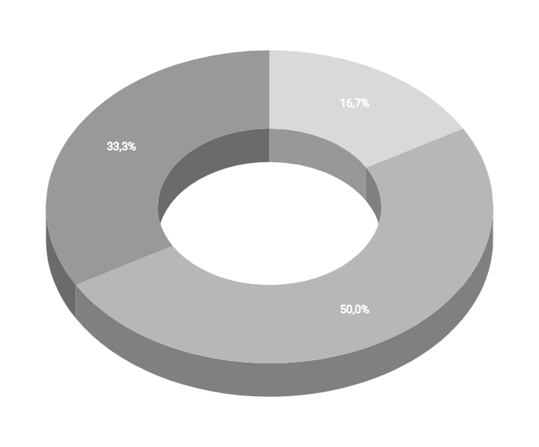
You can insert graphs from Google Sheets

Slide 30
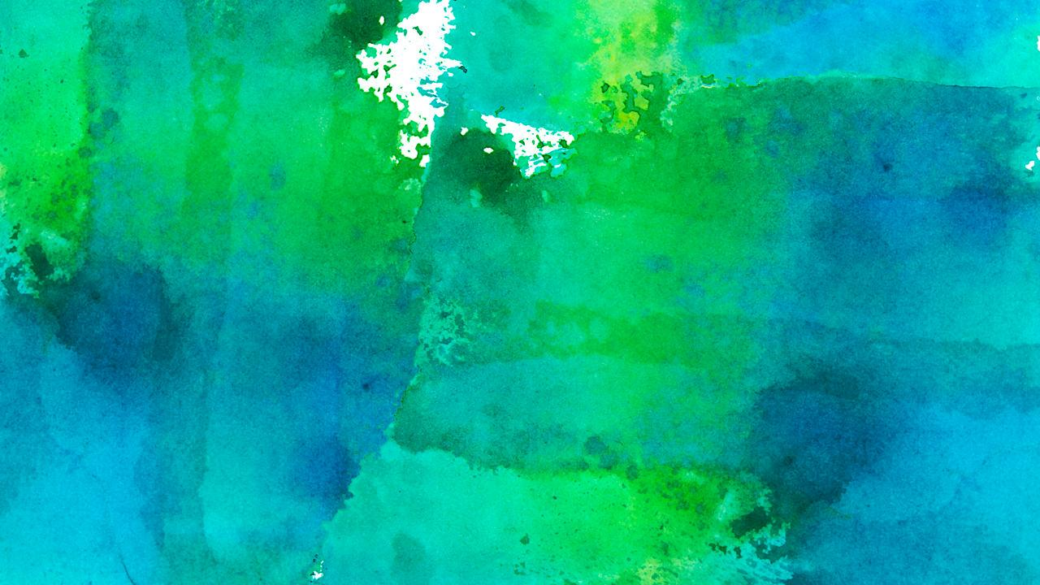
Android project
Show and explain your web, app or software projects using these gadget templates.
Place your screenshot here

Slide 31
iPhone project
Show and explain your web, app or software projects using these gadget templates.
Place your screenshot here

Slide 32
Tablet project
Show and explain your web, app or software projects using these gadget templates.
Place your screenshot here

Slide 33
Desktop project
Show and explain your web, app or software projects using these gadget templates.
Place your screenshot here

Slide 34
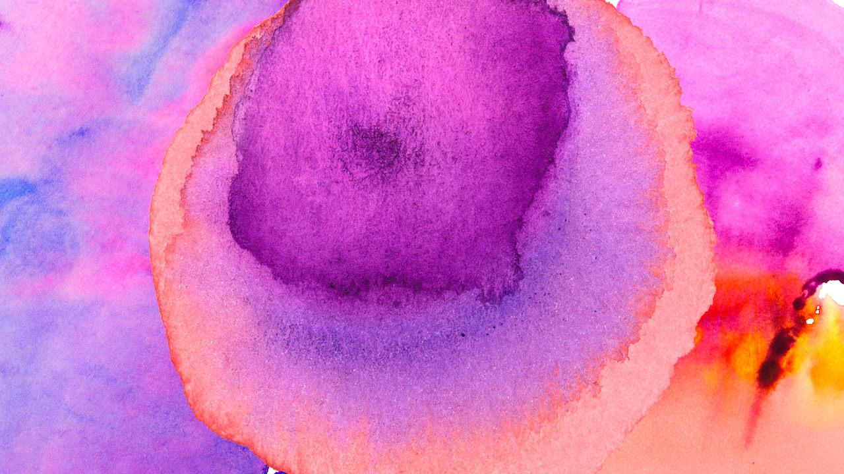
Thanks!
Any questions?
You can find me at:
@username
user@mail.me

Slide 35
Credits
Special thanks to all the people who made and released these awesome resources for free:
Presentation template by SlidesCarnival
Photographs by Unsplash
Watercolor textures by GraphicBurguer

Slide 36
Presentation design
This presentation uses the following typographies and colors:
Titles: Lato Thin
Body copy: Lato Light
You can download the fonts on this page:
http://www.latofonts.com/lato-free-fonts/
You don’t need to keep this slide in your presentation. It’s only here to serve you as a design guide if you need to create new slides or download the fonts to edit the presentation in PowerPoint®

Slide 37
SlidesCarnival icons are editable shapes.
This means that you can:
Resize them without losing quality.
Change fill color and opacity.
Isn’t that nice? :)
Examples:

Slide 38
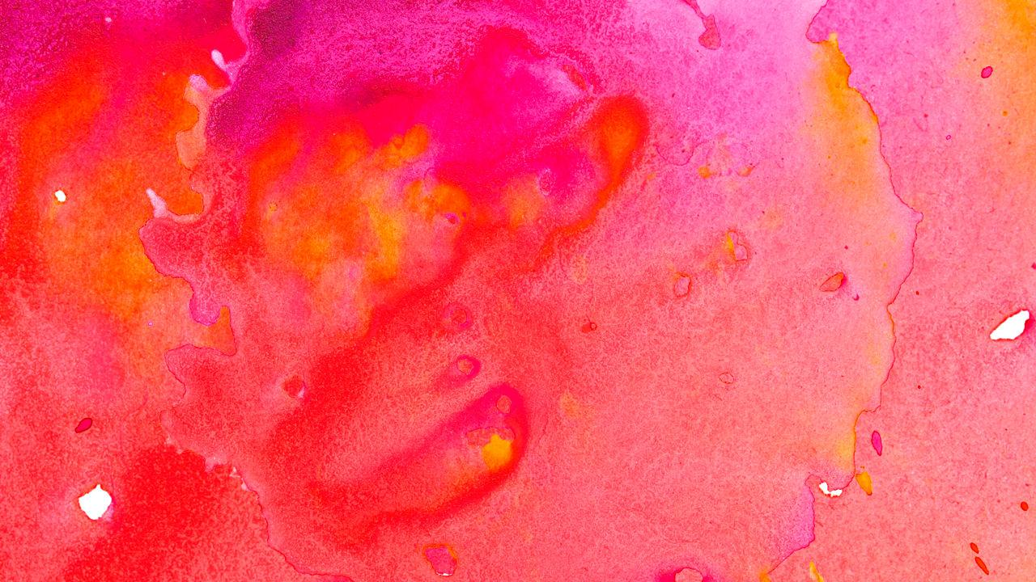
😉
Now you can use any emoji as an icon!
And of course it resizes without losing quality and you can change the color.
How? Follow Google instructions https://twitter.com/googledocs/status/730087240156643328
✋👆👉👍👤👦👧👨👩👪💃🏃💑❤😂😉😋😒😭👶😸🐟🍒🍔💣📌📖🔨🎃🎈🎨🏈🏰🌏🔌🔑 and many more...

